Slide 1
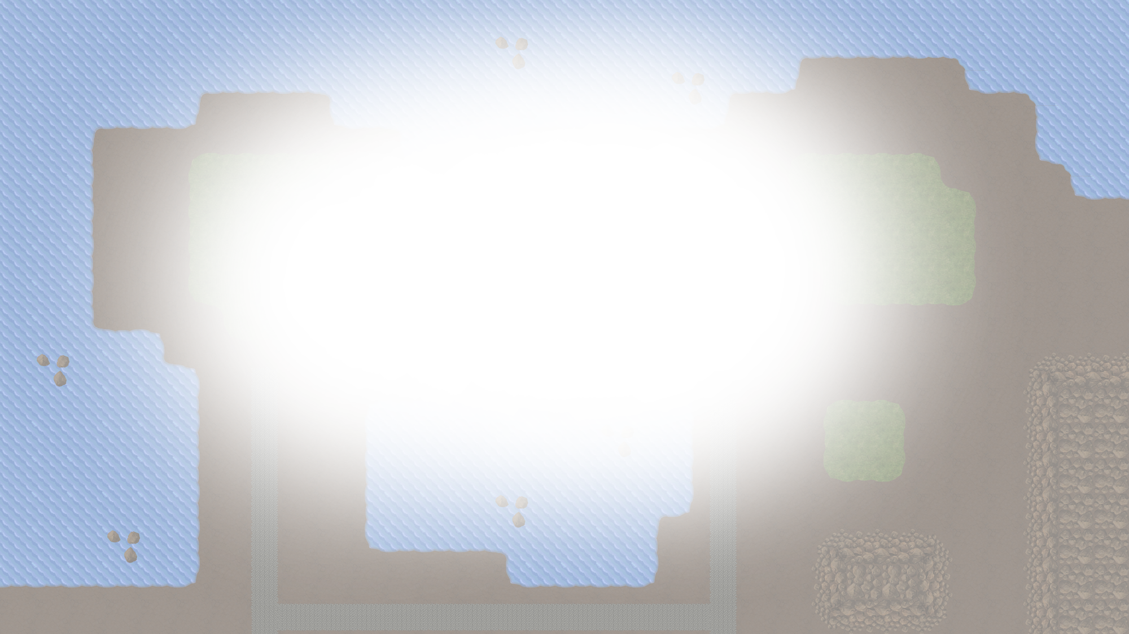






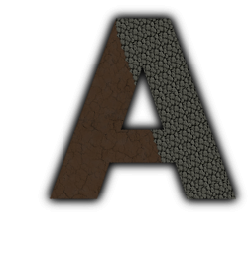
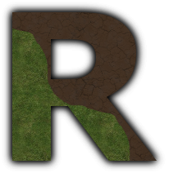

Majaro – Matt, James, Rob
Majario – Matt, James, R(i)ob

Slide 2
Game Origins & Inspirations
The types of game we considered included reaction, simulation, risk and real-time strategy (RTS).
As a team we picked our top three favourites and concluded on making an RTS game inspired by the Red Alert series.
To ensure the game was original we discussed what we felt was missing from RTS games.
Resultantly we felt by being browser-based for accessibility and by implementing a full top-down implementation our game was unique.

Slide 3
What we did
Initially we created a plan on everything we wanted to include in the game, from start to finish.
We tailored the plan to make it scalable in case we were hindered by time constraints.
We implemented the game from the ground up working on the game fundamentals before finally creating the game itself.
Our testing was performed through mostly user acceptance testing as this exposed both bugs and better game balance feedback.

Slide 4
How we did it PART 1
During the first week we spent most of the time in meetings discussing exactly what we wanted the game to be.
We attempted to work in weekly sprints to produce a deliverable for each Friday (although this did not always come to fruition!)
By using GIMP we designed all of the sprite sheets for our game to keep the content original.
Towards the end of the six week project, we played the game a lot to try and address game balance issues.

Slide 5
How we did it PART 2
The key technologies used were Java for creating the server, JavaScript for the client side (including Angular.JS and Phaser.io frameworks) and MySQL for the database.
By being mindful of the technologies available we were able to choose those that would be most relevant to what we will be doing in the coming weeks.
Ultimately this would all have been for nought without sheer determination, hard-graft and a little bit of luck!

Slide 6
Created Resources
Created using GIMP
Original design

Slide 7
Why we did it that way PART 1
When choosing what technologies to use we were mindful to choose those that were available and used within Scott Logic.
For the server we chose to go with Java as it is would enable us to learn a technology more commonly used in project work.
Although there are many options available we chose Phaser.io for graphics handling on the client side as it supported WebGL rendering.
We also opted to use MySQL for the database side of things as it is a freely available yet more than capable solution.

Slide 8
Why we did it that way PART 2
By aiming to produce a deliverable at the end of every week, we were able to keep track of our progress as time went on.
Our mentors helped support us in doing this by dedicating one of our stand-ups per week to us demonstrating what we had created so far.
We found user acceptance testing more effective as it enabled us to discover bugs and address gameplay issues simultaneously.

Slide 9
Challenges
Learning new technologies
Java, JavaScript, Phaser primarily
Use of Netty with Java for sockets
Random disconnects cost us a lot of development time
Original idea was over ambitious
Use of Eclipse and GIT

Slide 10
What would we do differently?
Fully plan each week
And stick to this plan rigidly
Implement a single feature at a time
In the form of proper weekly sprints
Use a different IDE

